Slide 1
Graph

Slide 2
GRAPH TERMINOLOGIES

Slide 3
What is a Graph?
A graph is a pair of sets (V, E), where V is a set of nodes, called vertices E is a collection of pairs of vertices, called edges
V(G) and E(G) represent the sets of vertices and edges of G, respectively.
We visualize/draw the graph and store represent it mathematically using the two sets.
b
a
d
V= {a,b,c,d,e}
E = {(a,b),(b,c), (b,d), (c,e), (d,e)}
c
e

Slide 4
Edge and Graph Types
Directed edge
ordered pair of vertices (u,v)
first vertex u is the origin
second vertex v is the destination
Undirected edge
unordered pair of vertices (u,v)
Directed graph (Digraph)
all the edges are directed
e.g., route network
Undirected graph
all the edges are undirected
e.g., flight network
Mixed graph
some edges are undirected and some edges are directed
e.g., a graph modeling a city map
a
b
Directed edge
a
b
Undirected edge
a
b
c
d
e
Mixed graph

Slide 5
Terminology
End vertices (or endpoints) of an edge
u and v are the endpoints of a
Edges incident to a vertex
a, d, and b are incident to v
Adjacent vertices
u and v are adjacent
Degree of a vertex
x has degree 5
Parallel edges
h and i are parallel edges
Self-loop
j is a self-loop
v
a
b
h
j
u
d
x
z
c
e
i
w
g
f
y

Slide 6
Terminology (cont.)
Outgoing edges of a vertex
(a, b) and (a, c) are outgoing edges of vertex a
Incoming edges of a vertex
(b, c), (d, c) and (a, c) are incoming edges of vertex c
In-degree of a vertex
c has in-degree 3
b has in-degree 1
Out-degree of a vertex
a has out-degree 2
b has out-degree 1
a
b
d
c

Slide 7
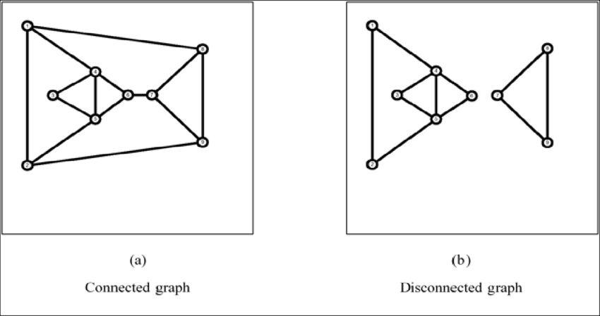
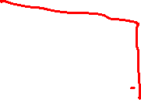
Terminology
In a graph G, two vertices, v0 and v1 , are connected if there is a path in G from v0 to v1.
A graph is connected if, for every pair of distinct vertices vi and vj , there is a path from vi to vj

Slide 8
GRAPH REPRESENTATIONS

Slide 9
Graph Representation
We can visualize/draw the graph.
We can represent it MATHEMATICALLY using the two sets V and E.
b
V= {a,b,c,d,e}
E = {(a,b),(b,c), (b,d), (c,e), (d,e)}
a
d
c
e

Slide 10
Graph Representation
We can visualize/draw the graph.
We can represent it in the COMPUTER MEMORY using any of the two approaches
Adjacency Matrix
Adjacency List
b
a
d
c
e

Slide 11
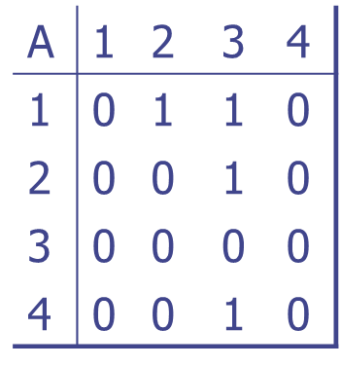
Graph Representation
Assume V = {1, 2, …, n}
An adjacency matrix represents the graph as a n x n matrix A:
A[i, j] = 1 if edge (i, j) ∈ E (or weight of edge) = 0 if edge (i, j) ∉ E
1
a
2
d
4
b
c
3

Slide 12
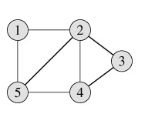
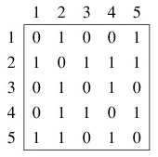
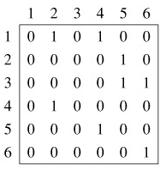
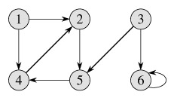
Adjacency Matrix Representation
Undirected Graph
Directed Graph
The adjacency matrix for an undirected graph is symmetric; i.e. : A[i][j]=A[j][i]
The adjacency matrix for a digraph need not be symmetric

Slide 13
Adjacency Matrix Representation
Pros:
Simple to implement
Easy and fast to tell if a pair (i, j) is an edge: simply check if A[i, j] is 1 or 0
Can be very efficient for small graphs
Cons:
No matter how few edges the graph has, the matrix takes O(n²) in memory

Slide 14
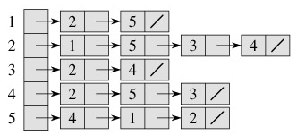
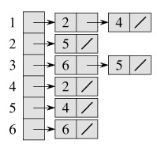
Adjacency Lists Representation
A graph is represented by a one-dimensional array L of linked lists, where
L is an array of pointers
L[i] is the linked list containing all the nodes adjacent to node i.
Undirected Graph
Directed Graph

Slide 15
Adjacency Lists Representation
Pros:
Saves on space (memory): the representation takes O(|V|+|E|) memory.
Good for large graphs
Cons:
It can take up to O(n) time to determine if a pair of nodes (i, j) is an edge: one would have to search the linked list L[i], which takes time proportional to the length of L[i].

Slide 16
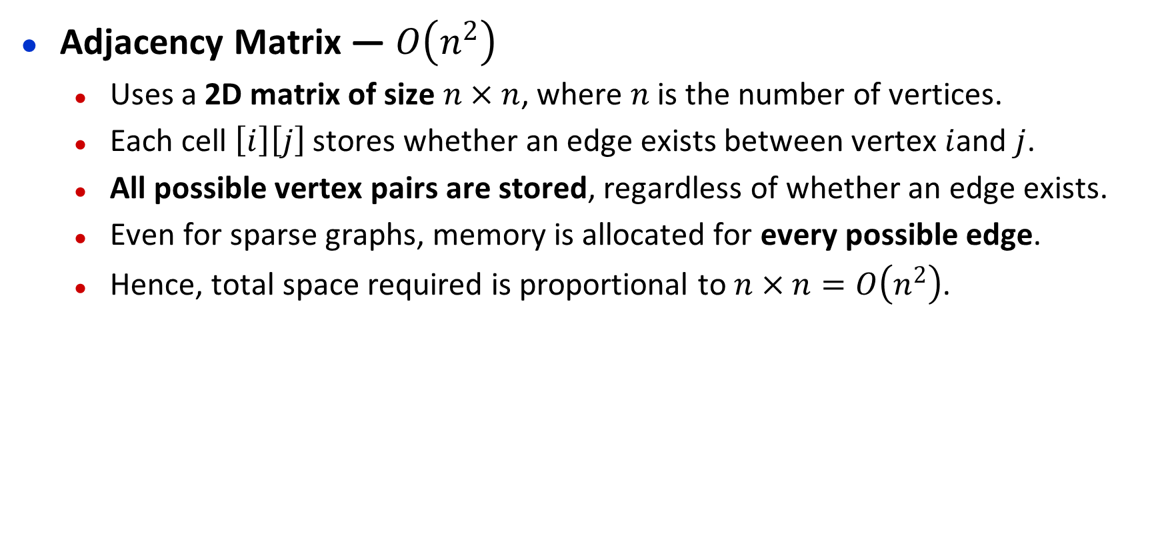
Adjacency Matrix Order
Adjacency Matrix — $O\left(n^{2}\right)$
Uses a 2D matrix of size $n×n$, where $n$is the number of vertices.
Each cell $\left[i\right]\left[j\right]$ stores whether an edge exists between vertex $i$and $j$.
All possible vertex pairs are stored, regardless of whether an edge exists.
Even for sparse graphs, memory is allocated for every possible edge.
Hence, total space required is proportional to $n×n=O\left(n^{2}\right)$.

Slide 17
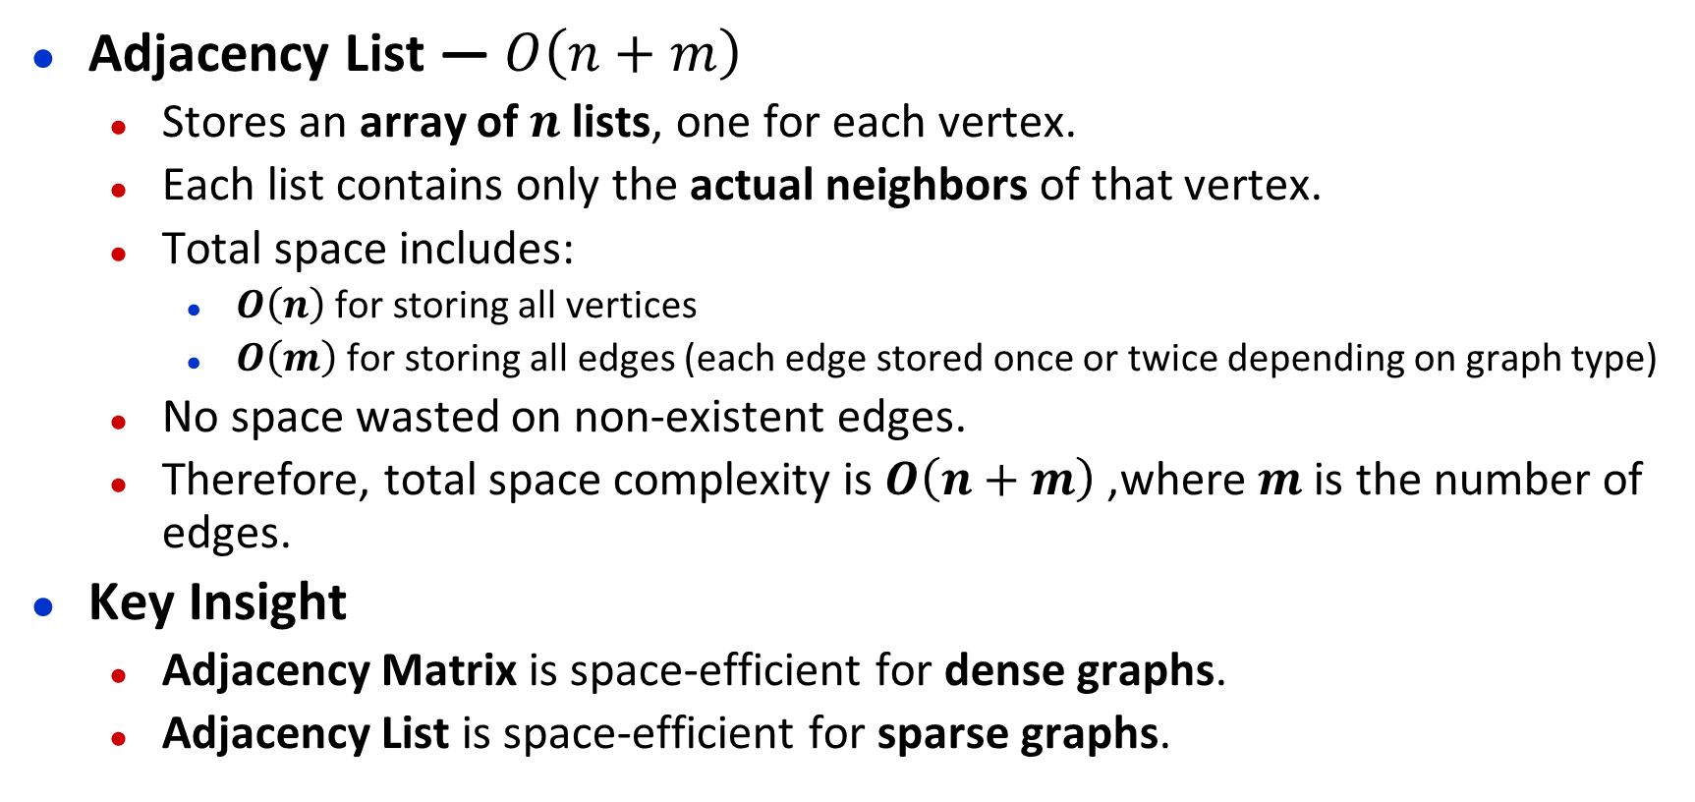
Adjacency Lists Order
Adjacency List — $O\left(n+m\right)$
Stores an array of $n$lists, one for each vertex.
Each list contains only the actual neighbors of that vertex.
Total space includes:
$O\left(n\right)$ for storing all vertices
$O\left(m\right)$for storing all edges (each edge stored once or twice depending on graph type)
No space wasted on non-existent edges.
Therefore, total space complexity is $O\left(n+m\right)$, where $m$is the number of edges.
Key Insight
Adjacency Matrix is space-efficient for dense graphs.
Adjacency List is space-efficient for sparse graphs.

Slide 18
Thank You

